Slide 1
URL for presentation: https://youtu.be/8PiI3Qh-jbA

Slide 2
Group 6
Chuyang Li (19cl98@queensu.ca): <leader>, Chuyang Li gave the report a brief start by doing the abstract and introduction and overview, also the derivation process, providing some thoughts in the sequence diagram of use cases. And analyze the subsystem role in the architecture. Provided some ideas in presentation creation as well.
Qintao Zhang (18qz28@queensu.ca): Qintao Zhang assists to analyze software architecture and draw sequence diagram as well as box-arrow diagram.
Anthony Zhou (18zz172@queensu.ca) - <slide preparation>, Anthony Zhou analyze software architecture and draw sequence diagram and box-arrow diagram
Wenchu Xiao (19wx25@queensu.ca): Wenchu xiao analyze software architecture and draw sequence diagram and box-arrow diagram.
Chang Xu (18cx19@queensu.ca): <presenting>, Chang Xu presented the video for the presentation and she did the architectural style and the transaction use case text description for the report, she also contributed to the graphical design of the transaction use case diagram.
Xiaoran Zhang(19xz64@queensu.ca): Allen Zhang is responsible for preparing the report, completing an in-depth analysis of Bitcoin's development team, the Bitcoin core system's evolution, concurrency processing, lessons and limitations.

Slide 3

Bitcoin Core
Group 6 Presented by Anthony Zhou, Chang Xu

Slide 4

What is Bitcoin Core?
Bitcoin Core is a computer program that connects to the Bitcoin network to check transactions and blocks.
Version 0.9.0
Version 0.18.0
Version 0.21.0

Slide 5
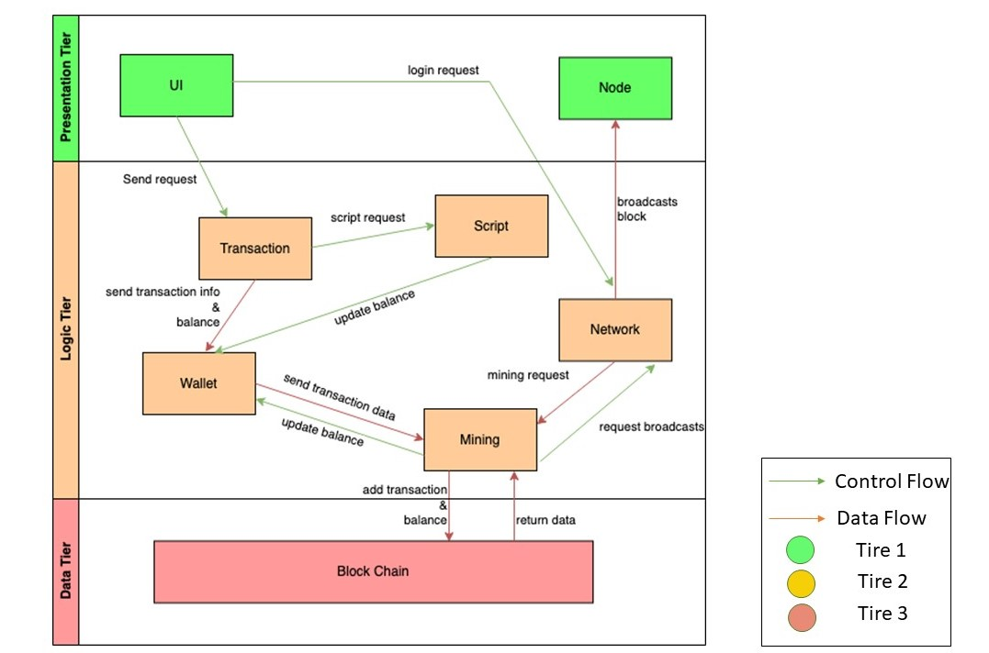
Conceptual Architecture Overview of Components
Figure 2. Conceptual Architecture

Slide 6
Subsystems
Transaction
Script
Wallet
Mining
Block Chain
Network

Slide 7
Derivation Process
get the general idea from bitcoin Core open-source book and developer manual
decide architectural style
in-depth understanding through usecase

Slide 8
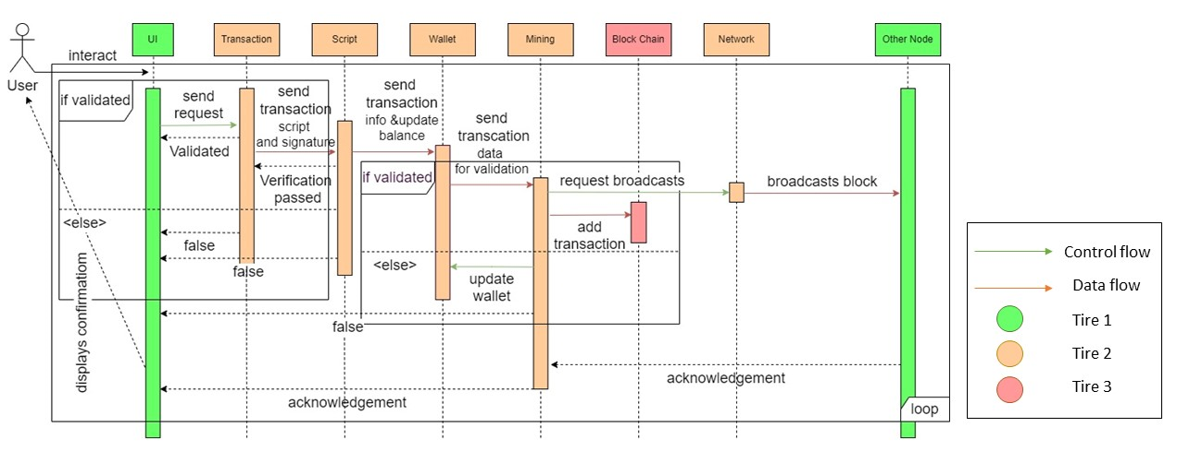
USE CASE #1: Transaction
Figure 4. Transaction sequence diagram

Slide 9
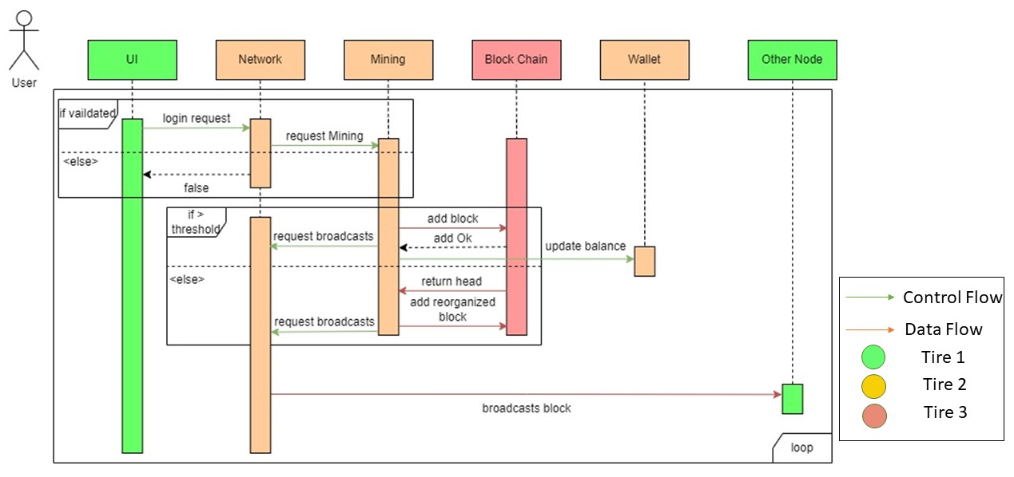
USE CASE #2: Solo Mining
Figure 5. Solo mining sequence diagram

Slide 10
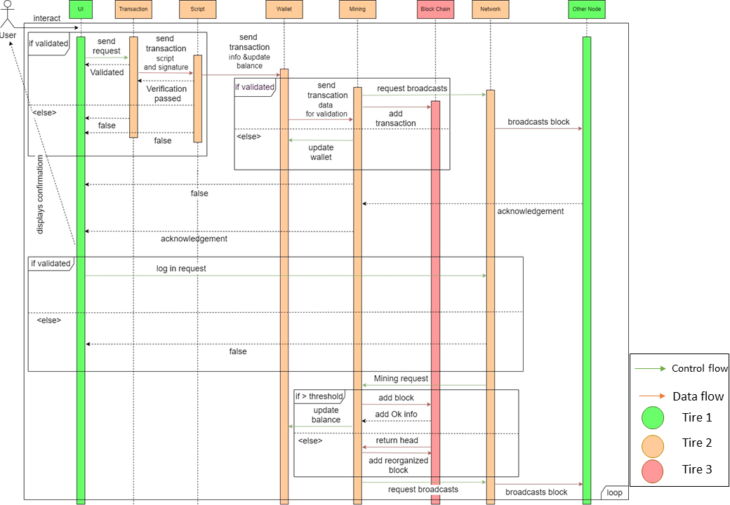
Control and Data Flow
Figure 3. Sequence diagram with control and data flow

Slide 11

- use multiple threads
- process multiple transactions
Concurrency
- consensus among network nodes
- peer-to-peer network

Slide 12

Limitations
Scalability - number of transactions that can be processed per second
Adoption - limited adoption is indeed a limitation of Bitcoin and other cryptocurrencies
Centralization - risk of centralization

Slide 13
Lesson Learned
Decentralization - emphasize the importance of enabling everyone to participate in the validation and processing of transactions
Security - security features like cryptographic protocols, private keys to protect users' asset
Transparency - allowing users to verify transaction validity and monitor the behaviour of other network participants

Slide 14

Thank you !

